Slide 1
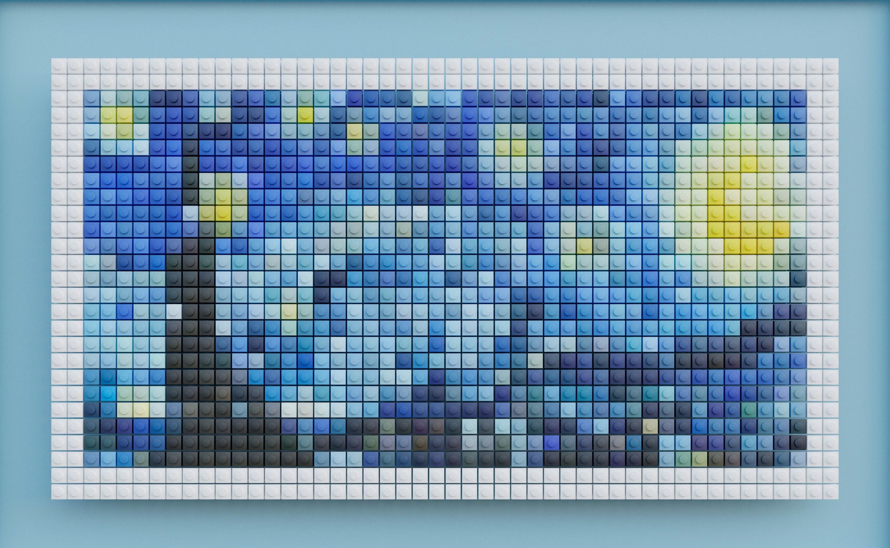
Introduction to Modern Controls
Discretization of State-Space System Models
SS Discretization

Slide 2

1TB vs 1,300 filing cabinets of paper
SS Discretization

Slide 3

Inherent sampling in practice
1
(rpm/60) × sector number
∆t =
SS Discretization

Slide 4
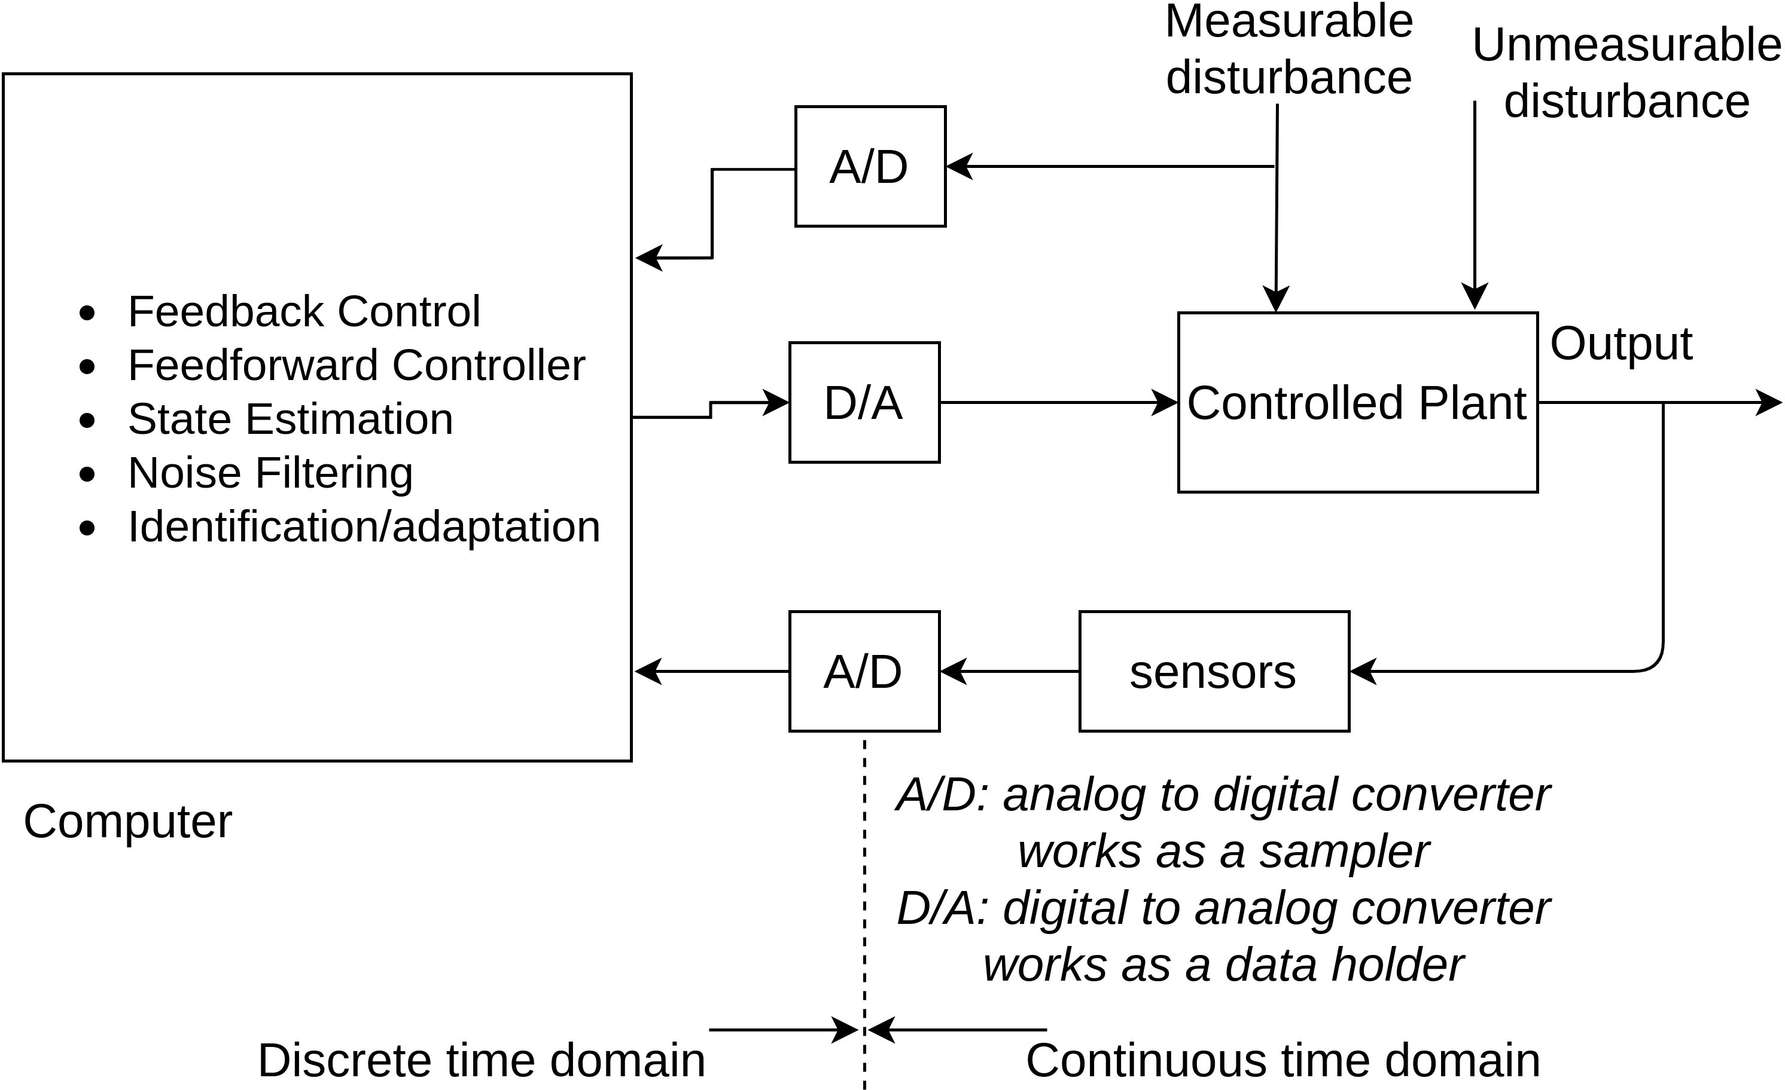
Practical control systems
SS Discretization

Slide 5
Sampler
sampler: converts a time function into a discrete sequence,
y(t)
y[k] ≜ y(t_{k}) = y(∆tk)
t
∆t
⇒
k
1 2 3
e.g.,
SS Discretization

Slide 6
Signal holding
Zero-order Hold (ZOH): converts a sequence into a “stair-case” time function, e.g.,
u[k] u(t)
ZOH
0
1
2
3
k
0
∆t
2∆t
3∆t
t
u(t) = u[k] for t ∈ [k∆t, (k + 1)∆t)
SS Discretization

Slide 7
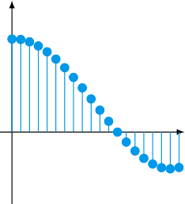
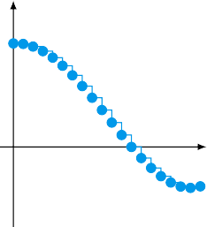
Signal holding
more faithful presentation with fast sampling
u[k]
u(t)
k
._- -._ _{t}
ZOH
SS Discretization

Slide 8
Problem definition
continuous-time system preceded by a ZOH:
u(tk)
Zero Order Hold
dx/dt = Ax + Bu
x(t)
x(tk)
∆t
u(t_{k}): discrete-time input
x(t): continuous-time output
x(t_{k}): sampled discrete-time output
∆t: sampling time
goal: to obtain the model between u(t_{k}) and x(t_{k})
SS Discretization

Slide 9
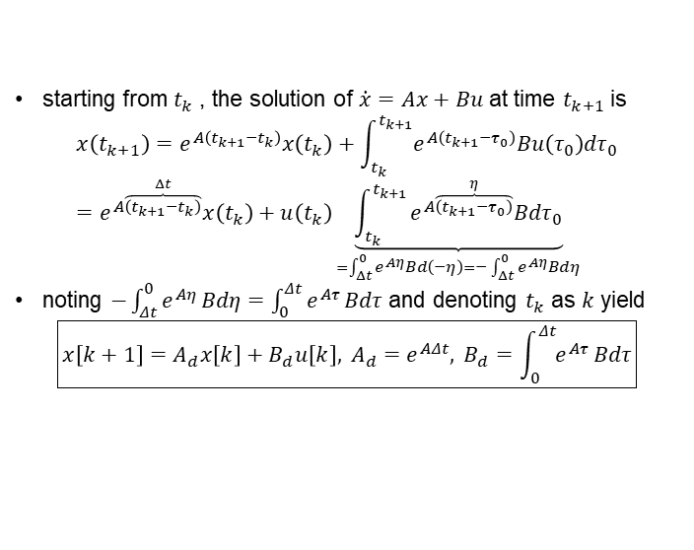
Solution
u(tk)
Zero Order Hold
dx/dt = Ax + Bu
x(t)
x(tk)
starting from $t_{k}$, the solution of $\dot{x}=Ax+Bu$ at time $t_{k+1}$ is
$$x\left(t_{k+1}\right)=e^{A\left(t_{k+1}−t_{k}\right)}x\left(t_{k}\right)+\int_{t_{k}}^{t_{k+1}}{e^{A\left(t_{k+1}−τ_{0}\right)}Bu\left(τ_{0}\right)dτ_{0}}=e^{A\overset{Δt}{\overbrace{\left(t_{k+1}−t_{k}\right)}}}x\left(t_{k}\right)+u\left(t_{k}\right)\underset{=\int_{Δt}^{0}{e^{Aη}Bd\left(−η\right)=−}\int_{Δt}^{0}{e^{Aη}Bdη}}{\underbrace{\int_{t_{k}}^{t_{k+1}}{e^{A\overset{η}{\overbrace{\left(t_{k+1}−τ_{0}\right)}}}Bdτ_{0}}}}$$
noting $−\int_{Δt}^{0}{e^{Aη}}Bdη=\int_{0}^{Δt}{e^{Aτ}}Bdτ$ and denoting $t_{k}$ as $k$ yield
$$\boxed{x\left[k+1\right]=A_{d}x\left[k\right]+B_{d}u\left[k\right], A_{d}=e^{AΔt}, B_{d}=\int_{0}^{Δt}{e^{Aτ}}Bdτ}$$
SS Discretization

Slide 10
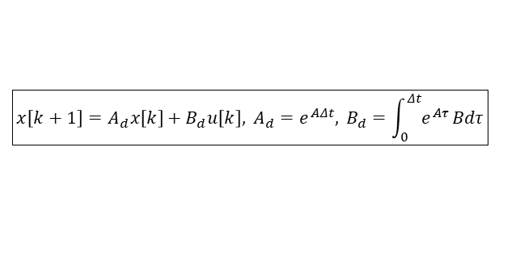
Mapping of eigenvalues
$$\boxed{x\left[k+1\right]=A_{d}x\left[k\right]+B_{d}u\left[k\right], A_{d}=e^{AΔt}, B_{d}=\int_{0}^{Δt}{e^{Aτ}}Bdτ}$$
diagonalization / Jordan form: A = T⁻¹ΛT e^{At} has the same eigenvalues as e^{Λt}
⇒ eigenvalues of A_{d} = e^{A∆t} are e^{λi∆t}’s where λ_{i} is an eigenvalue of A
SS Discretization

Slide 11
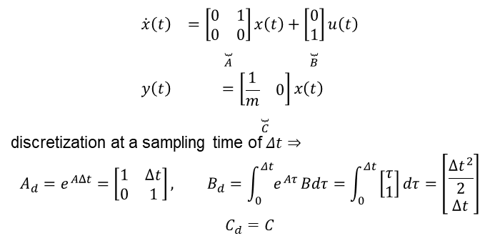
Example
$$\begin{matrix}\dot{x}\left(t\right) & =\underset{A}{\underset{⏟}{\left[\begin{matrix}0 & 1 \\ 0 & 0\end{matrix}\right]}}x\left(t\right)+\underset{B}{\underset{⏟}{\left[\begin{matrix}0 \\ 1\end{matrix}\right]}}u\left(t\right) \\ y\left(t\right) & =\underset{C}{\underset{⏟}{\left[\begin{matrix}\frac{1}{m} & 0\end{matrix}\right]}}x\left(t\right)\end{matrix}$$
discretization at a sampling time of $Δt⇒$
$$A_{d}=e^{AΔt}=\left[\begin{matrix}1 & Δt \\ 0 & 1\end{matrix}\right], B_{d}=\int_{0}^{Δt}{e^{Aτ}}Bdτ=\int_{0}^{Δt}{\left[\begin{matrix}τ \\ 1\end{matrix}\right]dτ=\left[\begin{matrix}\frac{Δt^{2}}{2} \\ Δt\end{matrix}\right]}$$
$$C_{d}=C$$
SS Discretization

Slide 12
Numerical example in Python
import control import numpy
m = 1
dt = 0.1
A = [[0, 1], [0, 0]]
B = [[0], [1]]
C = [[1/m, 0]]
D = 0
G_s = control.ss(A, B, C, D)
G_z = control.c2d(G_s, dt, 'zoh') print(G_z.A)
# eigenvalues of continuous-time system eigA, eigvecA = numpy.linalg.eig(A) print(eigA)
# eigenvalues of discretized system eigAd, eigvecAd = numpy.linalg.eig(G_z.A) print(eigAd)
SS Discretization
12 / 12

Slide 13
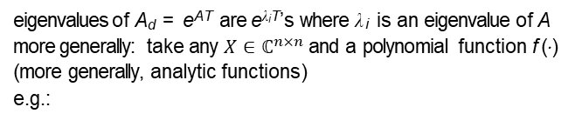
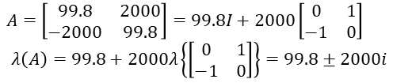

Spectral mapping theorem
eigenvalues of A_{d} = e^{AT} are e^{λiT}’s where λ_{i} is an eigenvalue of A more generally: take any $X∈ℂ^{n×n}$ and a polynomial function f (·) (more generally, analytic functions)
e.g.:
$A=$ $\left[\begin{matrix}99.8 & 2000 \\ −2000 & 99.8\end{matrix}\right]=99.8I+2000\overset{X}{\overbrace{\left[\begin{matrix}0 & 1 \\ −1 & 0\end{matrix}\right]}}$
then
eig (f (X)) = f (eig (X))
e.g.:
$A=$ $\left[\begin{matrix}99.8 & 2000 \\ −2000 & 99.8\end{matrix}\right]=99.8I+2000\left[\begin{matrix}0 & 1 \\ −1 & 0\end{matrix}\right]$
$$λ\left(A\right)=99.8+2000λ\left\{\left[\begin{matrix}0 & 1 \\ −1 & 0\end{matrix}\right]\right\}=99.8±2000i$$
SS Discretization
12 / 12

Slide 14

Spectral mapping theorem
$A=$ $\left[\begin{matrix}99.8 & 2000 \\ −2000 & 99.8\end{matrix}\right]$
import numpy
A = [[99.8, 2000], [-2000, 99.8]]
eigA, eigvecA = numpy.linalg.eig(A) print(eigA)
[99.8+2000.j 99.8-2000.j]
SS Discretization
12 / 12

